Slide 1



COMPSCI 326
Join on Zoom if you are remote (see Moodle for link).
Lecture 01: Course Introduction

Slide 2
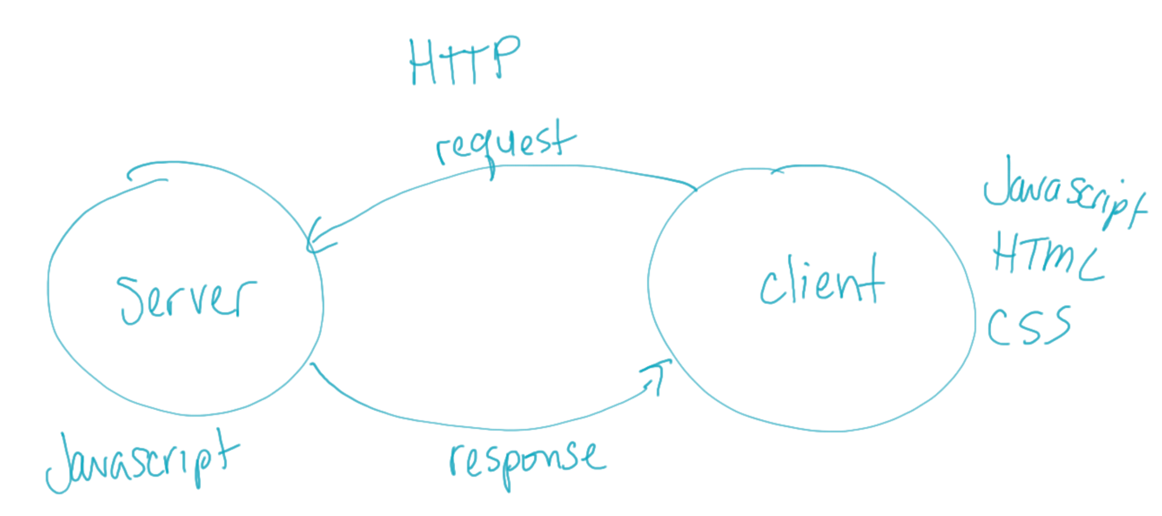
What is this course about?
Web Programming
JavaScript
HTML
CSS
Hypertext Transfer Protocol (HTTP)
Client programs
Server programs

